Slide 1
Internet Safety
Presented by: Sergeant K. Adams

Slide 2
Internet Safety for Parents, Guardians, and Communities
Notes:
(Introduce yourself.)

Slide 3
NetSmartz
Notes:
This presentation was created by the National Center for Missing and Exploited Children. The National Center's mission is to
Find missing children
Reduce child sexual exploitation
Prevent Future Victimization
NetSmartz is a safety program that:
Teaches children ages 5 to 17 about how to make better choices online and become responsible digital citizens.
Guides parents in protecting their children online.
Offers a variety of free resources, including games, videos, classroom lessons and presentations like this one.
You can find these resources at MissingKids.org/NetSmartz and more about all of the National Center's prevention programs at MissingKids.org/Education

Slide 4
Ways Kids Go Online
Notes:
Throughout this presentation, we’re going to talk about ways you can protect your children online no matter how they access the Internet.
Kids go online from:
School computers.
Friends’ computers.
Laptops and tablets.
Cell phones.
MP3 players like the iPod Touch.
E-readers like the Nook and Kindle.
Game consoles like the Nintendo Wii U, PlayStation 4 or Xbox One.
Handheld gaming devices like the Nintendo 3DS or the PlayStation Vita.
Technology changes all the time, and kids are constantly finding the newest websites, apps and gadgets. It’s up to you to teach them the basic rules of Internet safety so they can use all of these responsibly.

Slide 5
What do your children do online?
Notes:
So what are your kids currently interested in online?
(Pause for audience response. If you need to prompt the audience, use the questions below. Take note of their answers and tailor your presentation to their children’s current interests.)
How many of your children like to:
Use social media sites and apps like Facebook, Twitter, Instagram, Kik or Yik Yak?
Text or play games on your cell phone or their own phones?
Use Google to help with their homework?
Play computer games or games on a PlayStation or Nintendo 3DS?
Play in a virtual world like MineCraft
Download music from iTunes?
Watch videos on YouTube?
Download apps from the App Store or Google Play?
Today we are not going to go through every website and app your child might be using. Excellent information about how to check your child's browser history, using privacy settings, and how to report on the various apps and websites your child may be using is readily available online. Remember- learning about specific apps only helps if you are learning about the apps your child is actually using. The best thing you can do is ask your child which apps he or she uses and then work through and explore the privacy and reporting functionalities together.

Slide 6
Technology can’t catch everything, so communicate
Notes:
But remember, the most important thing is to communicate with your children about what they’re doing online. Start the conversation by asking about their interests.
Ask them questions like:
What’s your favorite app?
Who do you talk to when you play games?
What kinds of pictures do you like to post?
Discuss these things with them regularly so they know you’re available and have an open mind. Kids need to know that you won’t freak out and stop them from going online if something happens. You may not be able to protect them from everything, but you can teach them how to make responsible choices when they encounter a problem.

Slide 7
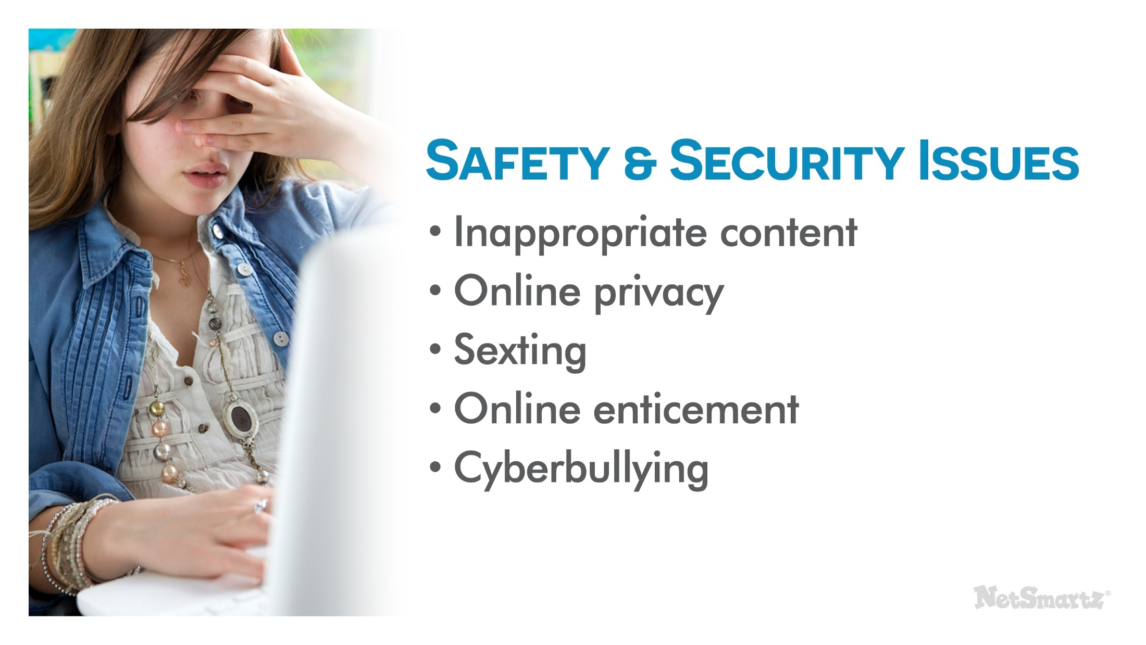
Safety and security Issues
Notes:
The good news is that most children are not getting into trouble online, but there are still risks to consider. The issues we’re going to discuss today are not specific to just one device or website. No matter what your children like to do online, they face the following issues:
Inappropriate content.
Online privacy.
Sexting.
Online sexual solicitation.
Cyberbullying.
You may think you don’t have to worry about cyberbullying because you have a younger child, or that your teenager already knows not to respond to inappropriate messages. But these topics are relevant to every child at some point. Today’s presentation will help you talk about them in a way that’s appropriate for your child’s age.

Slide 8
Talk about the risks and every age
Notes:
This chart shows how you can talk to your children about all of these online risks in an age-appropriate way. For example:
You should start talking about online manners, or “netiquette,” with your youngest children so they have a good foundation for later lessons about issues like cyberbullying.
You can start talking to your tweens about not posting revealing pictures and evolve that into a frank discussion about sexting when they become teenagers.
You can talk to young children about not trusting everyone they meet online. By the time they’re teens, they’ll be ready to discuss the risks of meeting offline.
Remember that the skills your child needs to practice safe behaviors online are skills built over time. Think about how we prepare children to ride in cars safely. We start by buckling them into car sears. As they grow to toddlers and preschoolers we still buckle them in, but we start to talk about WHY they need to be buckled in and we allow them to help us keep them safe by climbing into their own seats, helping with the buckles when they are able. We require compliance- we don't drive unless they are buckled, stop the car if they unbuckle themselves. We have these conversations many times over the years, we work with other adults to make sure they are also requiring compliance. Eventually when our children are in cars without us they have learned to wear their seatbelts through years of practice and of having that expectation set and enforced. When they start driving on their own we talk about requiring passengers to wear seatbelts as well. We don't start talking to them about wearing a seatbelt at 16. The same is true online- from the very beginning of a child's access to anything online parents need to talk to children in an age-appropriate way about safe behavior online. These conversations must be regular and active at all ages.
The information you learn in this presentation will help prepare you for all of these discussions.

Slide 9
Inappropriate Content
Notes:
Let’s start by discussing the inappropriate things your child may encounter online. The Internet opens up an entire world of information and images, some of which you don’t want your children to see. On the Internet, your child might come across content that features:
Pornography.
Excessive violence.
Hate speech.
Risky or illegal behaviors.

Slide 10
How to respond
Notes:
Seeing inappropriate content online may have negative effects on children. Some kids, especially younger children, may feel guilty or ashamed. Sometimes children exposed to violent or sexual content may become desensitized to it and this can affect their self-image and overall development.
Let your kids know they can always talk to you. The Internet is a great tool for them, so don’t make it scary. If your child does open up to you about inappropriate content they’ve seen, listen attentively and stay calm. Reassure them that it’s not their fault and help them report anything that made them feel uncomfortable. If you believe they received the inappropriate content from a friend or shared it with someone else, you may want to talk to a teacher or school counselor.
Again, the goal is to have regular and active conversations so that the conversation is open and ongoing, not just reacting to negative incidents or behaviors.

Slide 11
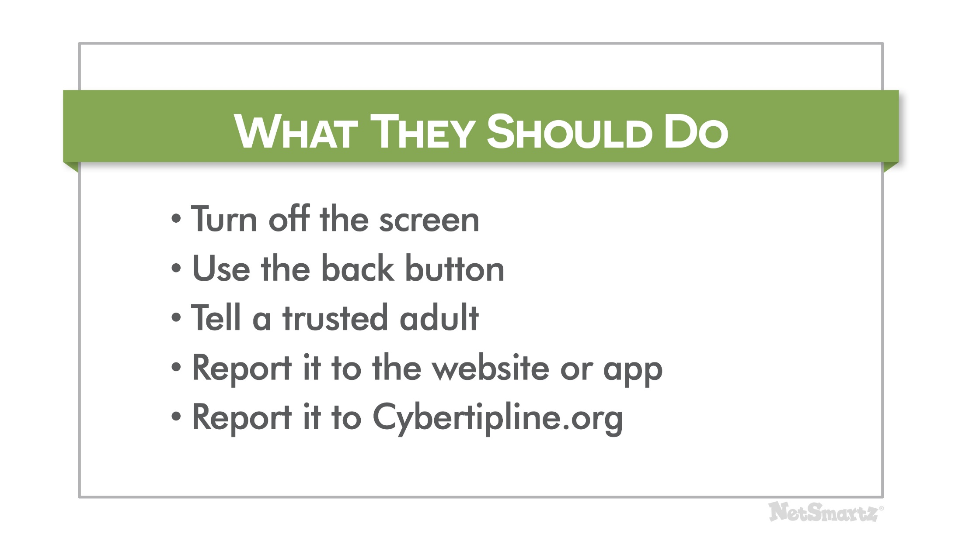
What they should do
Notes:
Next, talk to your child about what to do when they find inappropriate content. They can:
Turn off the screen.
Use the back button.
Tell a trusted adult if they have questions or need help.
Report the content to the website or app where they found it.

Slide 12
Don’t post
Notes:
In addition to talking to children about what to do if they see inappropriate content, you’ll also want to talk to older children about not posting it themselves. Inappropriate information your child shouldn’t share online includes:
Illegal or inappropriate behavior.
Offensive language.
Threats of violence.
Underage drinking or drug use.
Hate speech.
Posting these things online means your child may:
Damage their reputation at school, in the workplace or among their friends.
Be punished at school if what they post breaks school rules.
Be charged with a crime if they are breaking a law.
Hurt their chances of getting into college, getting a scholarship or getting a job in the future.
Examples from the news
Two high school students from Massachusetts were suspended after posting a homecoming picture of themselves holding replica guns. Even though the guns were not real, school officials considered the photos to pose a significant disruption to the school. ¹
A Minnesota teen posted a comment online claiming to have kissed one of his teachers. Although he later said he was just joking and the allegations were untrue, he was suspended for violating the school’s code of conduct and later transferred schools. ²

Slide 13
What you can do
Notes:
Connect
Set some ground rules. Establish clear guidelines like what types of sites kids can visit, apps they can download, and when they can have access to electronics. Consider “blackout” periods that require disconnection.
Research before you buy. It’s important to learn about a device’s capabilities before you buy. Will it allow unknown people to communicate with my child? Will this allow children to make unchecked purchases?
Go beyond safeguards. Installing monitoring software doesn’t guarantee your child will be safe online. Time, attention, and active conversation are the best tools to protect them.
REPORT! If your kids are dealing with cyberbullies or potential online enticement, report it to the website, cell phone provider, law enforcement, or www.cybertipline.org.
Learn
Know the platforms. Online enticement happens across all platforms, so be aware of the sites, games, and apps your children frequent. Ask them to show you how they use them.
Be proactive. Teach your kids to spot common tricks used by online offenders. In NCMEC CyberTipline reports, the most common tactics used to entice a child online were:
Engaging the child in sexual conversation/ roleplay as a grooming method.
Directly asking the child for sexually explicit images of themselves, or offering to mutually exchange images.
Developing a rapport with the child through compliments and other supportive behaviors such as “liking” their online posts.
Sending unprompted sexually explicit images of themselves.
Pretending to be younger.
Offering incentives for explicit content.
Spot the Red Flags. A child who is experiencing online enticement may be:
Spending increasing time online.
Getting upset when he or she is not allowed on their device.
Taking extra steps to conceal what they are doing online.
Receiving gifts from people you don’t know.
Engage
Talk about it! Your kids might not tell you everything, but ask anyway. Regular conversations about safety can go a long way in increasing trust and communication.
Get involved. Challenge them to a duel. If you have kids who like to play online games, ask if you can play, too. When you respect their interests, they’re more likely to respect your rules.
Don’t pull the plug. Taking away internet access because they may have made mistakes online doesn’t solve the problem. Talk to them about protecting themselves and respecting others online.

Slide 14
Online privacy
Notes:
You may also be concerned about how much information your children are sharing online. Some examples of things that are probably OK for them to share include:
Pictures of family and friends - As long as they are posted with permission, most pictures kids post are harmless. Kids love to take and post pictures as a way to express themselves and document their lives.
Casual conversation in a game - Many kids play computer games or games on a console like Xbox that allow them to talk to other players. For example, kids on Club Penguin can talk to each other, but the website uses strict chat filters and pre-selected questions and answers. Other games, like Call of Duty, allow kids to talk directly to other players on headsets. This kind of casual conversation is usually fine when kids stick to talking about the game.
However, there are certain kinds of personal information that you definitely don’t want your kids revealing.

Slide 15
Personal information
Notes:
Personal information that your children shouldn’t share publically online includes their:
Passwords.
Home address.
Location.
Home/cell phone number.
Email address.

Slide 16
Risks of sharing personal information
Notes:
Sharing personal information online is a security risk because it leaves your children open to:
Identity theft - Many identity thieves target children because you’re less likely to notice until your child is older, like when they apply for their first credit card. For example, they may steal children’s social security numbers, names and birthdates.
Online scams – Many children, especially young children, may be tricked into sharing passwords or visiting inappropriate websites by online scams promising prizes or money.
Hacking - Sharing passwords and other account details can result in someone hacking into children’s accounts and pretending to be them, or stealing files and other information you store on your computer.
Online Enticement- Online enticement involves an individual communicating with a child via the internet with the intent to commit a sexual offense or abduction. This is a broad category of online exploitation, that includes sextortion. where a child is being groomed to take sexually explicit images, meet face-to-face with someone for sexual purpose, or in some instances, to sell/trade the child’s sexual images.
Sextortion- A new online exploitation crime directed towards children in which non-physical forms of coercion are used, such as blackmail, to acquire sexual content from the child, engage in sex with the child, or obtain money from the child.
You may think it’s safer for your child to lie about their name and age online, but that’s not always true. For example, it’s actually against Facebook’s Terms of Service to use a fake name or age. All accounts of anyone under the age of 18 are not open to the public, so make sure teens sign up using their real birthdays. If they pretend to be older, their account has less default security restrictions.
Examples from the news
A teen in Indiana was using her laptop when the screen suddenly went blank. It then displayed a warning from what looked like the FBI telling her she was going to go to jail if she didn’t pay up. Her parents realized it was a scam, but not before the scam artist took control of the laptop to snap a photo of the teen. ³
One online scam lured kids onto gaming and survey websites by promising free stuff like video games. They were able to convince kids to give out their names, email addresses and other personal information. ⁴

Slide 17
What you can do
Notes:
Here’s what you can do to help your kids from revealing too much personal information online:
Establish rules about what they can share and under what circumstances - For example, it’s OK for them to enter their address online if they’re ordering something from Amazon with your permission, but it’s not OK to enter their address in a pop-up that promises to send them a prize.
Learn about the reporting options of any websites and games they’re using - Each website and game will have its own tools to report issues such as stolen passwords or hacked accounts. Get to know them so you know what to do if there is a problem.
Check privacy settings - You should help kids set up their accounts and check their privacy settings often to make sure they’re using the settings that offer the most protection.
Help them create strong passwords and tell them not to share them with anyone but you - Passwords should be at least 8 characters long. Try using silly words or phrases that are easy to remember. Never use personal information in a password and change them often.
Talk about friends lists - NetSmartz recommends that children only add friends they know offline, but this may change as they get older. Talk to them about the types of friends you’re OK with them adding.
Suggested Resources
Parents of younger children can check out the NetSmartzKids e-book, Delivery for Webster, that teaches kids about not entering personal information into pop-ups, and the video “The Password Rap,” that helps kids create a strong password. They are both available at www.NetSmartzKids.org.
Facebook’s Family Safety Center at www.facebook.com/safety is an excellent resource for parents who have questions about protecting their children’s privacy on the site. Other sites and apps that are popular with teens, like Twitter and Instagram, also have their own safety and security pages with tips on protecting personal information.

Slide 18
Sexting
Notes:
In addition to being careful about the kind of information they post, you want to make sure your children are being careful about the images they share. Sexting is when teens send or post nude or partially nude images, usually via cell phone.
It's hard to know for sure as the research varies widely, but recent studies suggest:⁵
15% of teens have sexted
27% of teens say they have received a sext

Slide 19
Why are they sexting
Notes:
Teens sext for a variety of reasons. They may be:
Trying to be funny and sharing it with friends.
Trying to impress a crush who may or may not have asked for the picture.
Peer pressure or threats
Experimenting with relationships, sexual behavior, and boundaries.
Sexting can be part of normal adolescent development that often includes risk-taking and boundary testing. However, one study found that teens who engage in sexting are more likely to be engaged in other risky sexual behaviors, including unprotected sex.⁶ This suggests that sexting is part of a pattern of risky behaviors for certain teens.

Slide 20
Consequences of sexting
Notes:
There are many consequences to sexting, some of which you saw in the video:
Humiliation at home, at school and online if the image spreads.
Bullying by peers, sometimes so extreme teens don’t want to go to school.
Blackmail by someone threatening to distribute earlier sexting images if they don’t send more.
Suspension or expulsion from school, or losing a spot on a school sports team.
Police involvement, which does not usually result in the teen being charged with a serious crime, but may result in mandated education programs or community service.

Slide 21
Addressing Sexting
Notes:
Here are some things you can do to address sexting with your child:
Talk to them about the consequences - They may not realize they can get in trouble at school or with the police. They also may not realize the image can stay online for a long time if it spreads.
Tell them never to forward a sexting image - This could mean big trouble at school and with the police. Plus, it’s a major violation of trust and exposes the person in the picture to potential ridicule.
Discuss healthy sexual relationships - Be open and honest; they should be able to talk to you about sexual things. Make sure they know what’s healthy and what’s not. Emphasize that anyone who pressures them to send a sexual picture is not someone they can trust.
Talk about ways an image can spread online – Even if your child thinks their boyfriend or girlfriend would never forward their picture, there are other ways a photo could spread, such as if a phone is lost, borrowed or stolen.
Report it to your child’s school or the police if you know a child is being blackmailed, a photo is being passed around without consent or a child is being bullied. Ignoring the situation will not help the child in the photo. You can also make a report with the National Center for Missing & Exploited Children’s CyberTipline at CyberTipline.org.
Suggested Resources
NetSmartz has tip sheets for teens and parents about sexting at MissingKids.org/NetSmartz/resources#tipsheets.

Slide 22
How do solicitations occur?
Notes:
The majority of sexual solicitations and aggressive solicitations occur among older teens. Most teens are solicited by their peers or young adults in a very casual way and report not being very bothered by it. Many of them simply remove themselves from the situation by blocking the person who sent the inappropriate request, asking them to stop, or leaving the site.⁸

Slide 23
Offenders groom children by:
Notes:
Although most teens aren’t bothered by sexual solicitations, there are some that lead to dangerous online relationships with predatory offenders. In these cases, the offenders begin to play on children’s vulnerabilities by offering them affection and attention. This manipulative process is called grooming.
Offenders entice children by:
Exploiting their natural curiosity about sex.
Lowering the child’s inhibitions by gradually introducing explicit images and child sex abuse images.
Using his or her adult status to influence and control a child’s behavior.
Offering gifts like cell phones and gift cards.
It is important to note that sexual exploitation and abuse does not always involve grooming. ALL inappropriate or exploitive behavior needs to be addressed and reported.

Slide 24
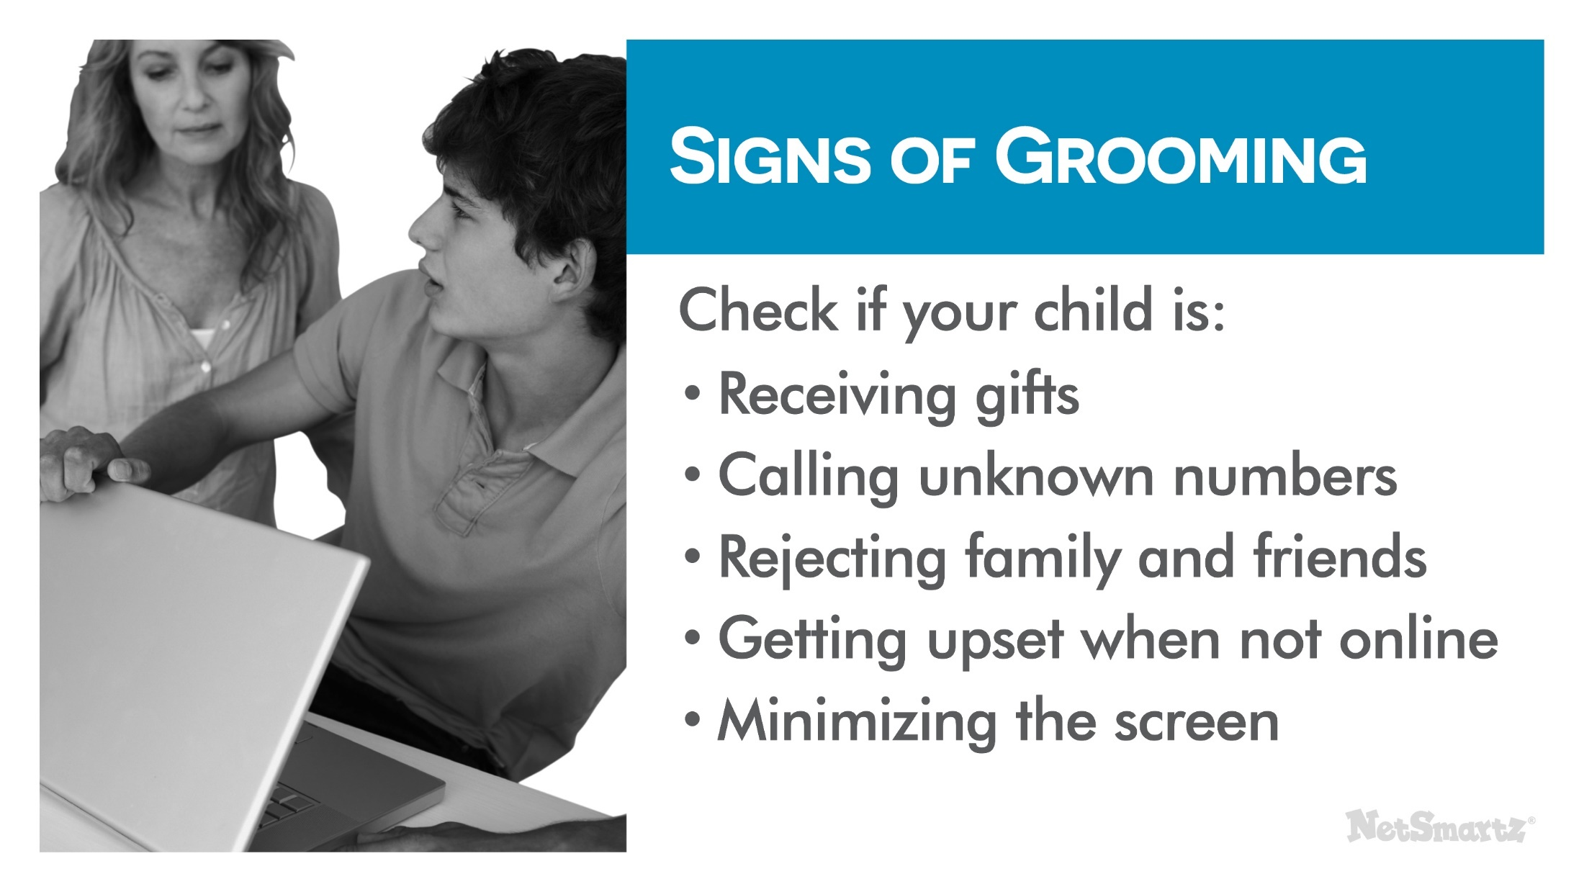
Signs of grooming
Notes:
Here are some signs of grooming you should look for. Check if your child is:
Receiving gifts through the mail, like bus tickets, cell phones and webcams.
Calling unknown numbers.
Rejecting family and friends in favor of spending time online.
Getting upset when he or she can’t get online.
Minimizing the screen or turning off the monitor when you come into the room.
If you see any of these signs, don’t ignore them. Talk to your children. Check out what they’re doing online and who they’re talking to. Get help immediately if you suspect something is wrong.
Again, all inappropriate, abusive, or exploitive behavior needs to be responded to and reported whether or not signs of grooming are present.

Slide 25
What you can do
Notes:
There are several things you can do to keep your child safe from predatory offenders:
Talk to your child about sex and relationships – Talk to them about what makes a healthy relationship. Have an open-door policy so they will not seek answers or inappropriate relationships online.
Keep in mind that many teens are flattered by attention from older people. Make it clear that a 22-year-old flirting with them is not flattering; it’s inappropriate.
This type of conversation can even start with young children. Talk to them about what is OK for people to talk about online and what is not OK.
Set a policy about meeting offline for older teens – If you’re not comfortable with it, then tell them they are not allowed to meet online friends in person. If you think it’s OK, then establish rules to make it safer. Suggested rules include having teens:
Get your permission before agreeing to meet.
Go with you or another adult.
Meet in a public place and not leave.
Know your child’s online friends - Encourage them not to accept friend requests from anyone they don’t already know. Ask questions about the people on their friends list, such as “How did you meet?” and “What do you talk about?” Keep in mind that some offenders use the Internet to target minors they already know. If someone your child knows contacts them online, they should check with you before responding.
Teach your child the warning signs - Talk to them about grooming and ways people may try to manipulate them.
Above all, call the police if you suspect your child is having inappropriate conversations or relationships online. You should also file a report with the website or app where they’ve had these conversations.

Slide 26
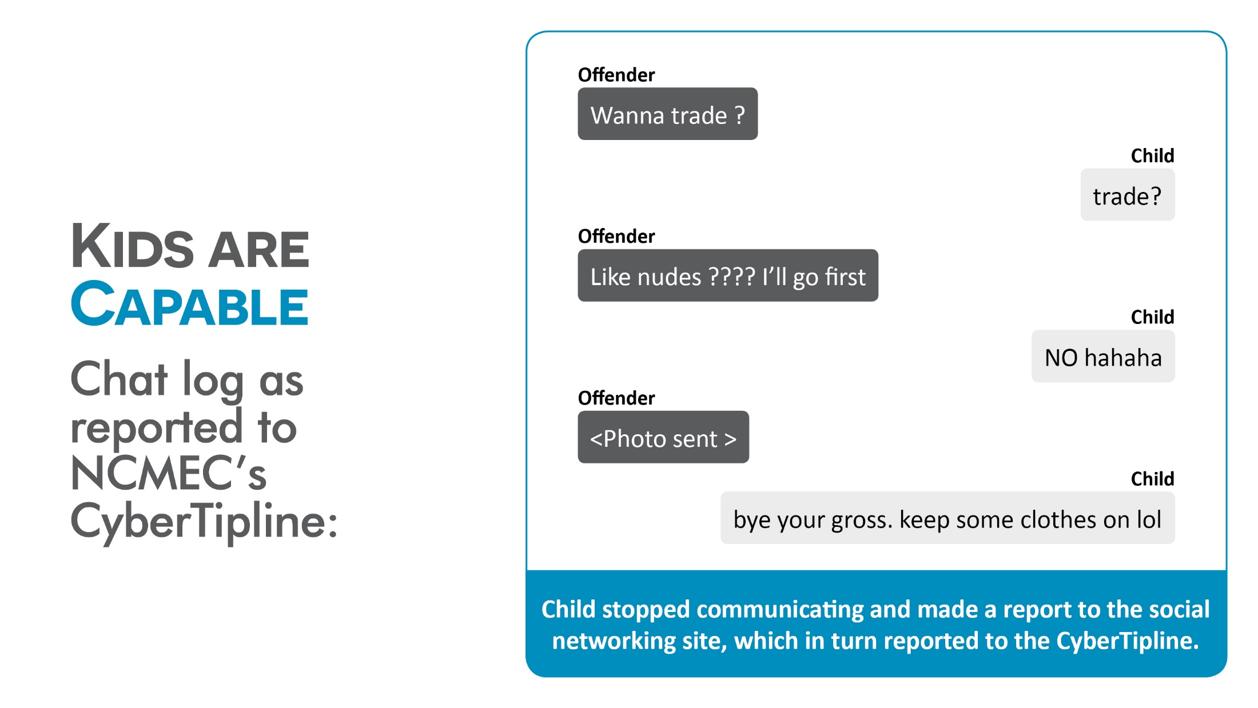
Kids are capable
Notes:
Here is an example of a 15 year old who made a report about inappropriate behavior online. Remind your children that even if they are not bothered by an inappropriate comment they should still report it to help keep the internet safe from others. Remind them that the person sending them inappropriate messages or pictures may try to do the same thing to another child who is younger or more vulnerable.

Slide 27
Report to the CyberTipline
Notes:
You can also make a report to the National Center for Missing & Exploited Children’s CyberTipline®. All reports made to NCMEC's CyberTipline are made available to law enforcement.
Make a Report If:
Anyone sends your child photos or videos containing obscene content.
Anyone asks your child to send sexual images.
Anyone speaks to your child in a sexual manner.
Anyone asks your child to meet in person.
You can contact them at www.CyberTipline.org or 1-800-THE-LOST®.

Slide 28
Cyberbullying
Notes:
How many of you have heard about cyberbullying? What do you know about it?
(Pause for audience response.)
Cyberbullying is exactly what it sounds like - bullying through technology like cell phones, social media sites and online games. Research tells us that:
About 25% of middle and high school students have been cyberbullied. ⁹
About 16% admitted to cyberbullying others.
Youth who identify as gay, lesbian, bisexual or questioning are more likely to be involved, both as a victim and a bully.¹⁰

Slide 29
Examples of Cyberbullying
Notes:
Some examples of cyberbullying include:
Sending someone mean texts.
Photoshopping or altering a picture to embarrass someone.
Creating a fake profile to post defamatory information or images.
Posting fight videos online to embarrass the person who lost.
Spreading rumors and gossip online.
Posting pictures intended to embarrass someone.
Sending threatening or harassing comments.
Even young children who don’t use social media or cell phones can experience some form of cyberbullying while playing online games or playing in a virtual world. For example, they may be:
Exposed to inappropriate language while chatting.
Taunted by other players.
Targeted by more experienced players.
Ignored by other players or excluded from playing.

Slide 30
Differences between cyberbullying and bullying
Notes:
Cyberbullying differs from regular bullying in a number of ways. It:
Often spreads faster than in-person bullying because of instant online communication.
Has a wider audience because it can easily be sent to a potentially unlimited amount of people.
Follows children home from school so they can’t get away from it.
All of this can undermine your child’s sense of security. They don’t feel a safe at school – because cyberbullies are frequently classmates and other peers – and they don’t feel safe at home because the bullying is happening 24/7 online.

Slide 31
Suicide among cyberbullying victims is rare
Notes:
You may have heard a lot about cyberbullying in the news because of highly-publicized teen suicides. It’s important to remember that although cyberbullying can be extremely devastating for some victims, suicide as a result of cyberbullying is extremely rare and there are usually other factors at play.
Researchers have looked at cases of cyberbullying-related suicide and found that:¹¹
Most teens who committed suicide were bullied both at school and online.
Many of the teens had some type of mental illness, such as depression.
Though it is rare for victims of cyberbullying to commit suicide, cyberbullying can still have very serious effects on the children who are targeted including depression, anxiety, academic problems, and more.

Slide 32
Cyberbully, Victim, Bystander
Notes:
As you can see, cyberbullying can have a tremendous impact on children. That’s why it’s so important for you to understand the issue. To combat cyberbullying, you need to know who is involved. Here are the major players:
Cyberbully - can be someone who instigates the bullying or someone who joins in.
Victim - the one being bullied, usually both online and offline.
Bystanders - those who stand by and watch the cyberbullying happen, but do nothing.
Your child may fall in at least one of these categories, sometimes more than one because many children who are cyberbullied also cyberbully others. They have also probably been bystanders at one point or another. Let’s talk about how to address children in each of these categories.

Slide 33
A cyberbullying victim might
Notes:
Because cyberbullying can be so far reaching, it greatly impacts its victims. If your child is being cyberbullied, he or she may:
Suddenly stop using the computer or cell phone.
Act nervous when receiving an email, IM or text.
Seem uneasy about going to school.
Withdraw from friends and family.
If you see any of these signs, don’t ignore them. Cyberbullying victims need to feel that you are taking the problem seriously and that you are going to do everything that you can to help.

Slide 34
How to help
Notes:
Here are some specific ways you can help if your child is a victim of cyberbullying:
Support your child- Stay calm but don't downplay the incident(s). Thank your child for coming to you about the cyberbullying. Review what happened together and see if there are steps the child can take to address the issue.
Consider saving the evidence – Ask the school or the police about taking screenshots and printing out any messages. If there is an investigation, they may want to see proof of what was posted.
Block cyberbullies – Tell your child not to respond to the messages and take advantage of website features that allow you to block any user who is bothering you.
Set up new accounts - This includes email, IM, social media sites and cell phone numbers. Make sure they only give the new information to friends they trust.
Talk to the school - Remember, most cyberbullying involves in-person bullying by someone your child knows, usually a classmate. Teachers and administrators should work together on a plan to address the bullying in school, and they may have specific rules against cyberbullying, too.
Report it to the website or app where the cyberbullying is taking place - You might also be able to report unwanted text messages to your cell phone provider and block certain numbers. If you feel that any laws have been broken or if your child has been threatened, then contact the police for help. You can also make a report to the CyberTipline.
Finally, remember to take your child seriously. Don’t use phrases like, “Kids will be kids.” Bullying can be very painful. Comfort your child by offering your support and understanding.

Slide 35
Cyberbullying behaviors
Notes:
Sometimes parents don’t find out that their children are cyberbullying others until they hear about it from another parent or from the school. Be proactive and look for these signs.
Your children may be involved with cyberbullying if they:¹⁵
Quickly switch screens or close programs when you walk by.
Use the computer at all hours of the night.
Get unusually upset if they cannot use the computer.
Laugh excessively while online.
Avoid discussions about what they are doing.
Use multiple online accounts or use an account that is not their own.
If you notice any of these behaviors, get involved and ask them to show you what they’re doing.

Slide 36
How to prevent it
Notes:
To help prevent your child from becoming a cyberbully, you can:
Establish expectations for online behavior - Make sure your child knows that you think bullying and cyberbullying are unacceptable.
Set consequences for cyberbullying - This will vary by family, but can include losing Internet privileges or more supervised Internet use.
Model good online behavior yourself - Children learn from the adults around them, so always be respectful of others online.
You don’t have to tell your children that they have to be friends with everyone, but you should teach them about respecting others. If you find out that your child has already been involved in cyberbullying, be open to working with the school as they look to correct the problem.

Slide 37
Talk to your child about not being a bystander
Notes:
Most kids are not bullies or victims; they are bystanders. They are afraid to speak up about cyberbullying because they’re afraid of being targeted next or being called a tattletale. However, information from bystanders is critical if teachers and other trusted adults are to take action.
Talk to your child about not being a bystander. You can do this by:
Establishing expectations for reporting - Make sure they understand that you expect them to speak up when they see cyberbullying happen because silence only lets it continue.
Encouraging them to stand up for the victim when they feel it’s safe to do so - That might mean being a good friend to the victim, telling the bully to stop or refusing to join in the cyberbullying. They can also show support to the victim in private.
Helping them report the cyberbullying to the website where it is taking place or to a trusted adult at school - Bystanders will feel better about reporting if they are reassured they’re doing the right thing, so help them see it through.

Slide 38
Tech options
Notes:
You’ve now heard several strategies to help you deal with inappropriate content, online privacy, sexting, online sexual solicitation and cyberbullying. Most of those suggestions have been based on communicating with your children, but I also want to talk about technological solutions.
Here are some options you may want to look into:
Filtering and monitoring software - These can help protect your children from seeing sexually explicit content online and even notify you if they’re receiving inappropriate messages. NetSmartz does not endorse any particular kind of software, but you can go to www.getnetwise.org to search for the software that best fits your needs.
Consult your cell phone service provider - They may offer monitoring options for your child’s cell phone.
Research options for mobile devices – Laptops, tablets, handheld games and MP3 players may have built-in monitoring options or software for purchase.
Look at the individual apps they’re using - Many apps have the option to turn off chat features or limit who can see what your child posts within the app.
Explore built-in security features for programs and websites - These often have their own privacy or filtering services. For example, Google has a free SafeSearch option. Each website or app has different privacy and filtering settings, so you should consult each one to help you better understand their systems. If you have specific questions, you can write to NetSmartz at MissingKids.org/contactus.

Slide 39
Technology can’t catch everything, so communicate
Notes:
But remember, the most important thing is to communicate with your children about what they’re doing online. Start the conversation by asking about their interests.
Ask them questions like:
What’s your favorite app?
Who do you talk to when you play games?
What kinds of pictures do you like to post?
Discuss these things with them regularly so they know you’re available and have an open mind. Kids need to know that you won’t freak out and stop them from going online if something happens. You may not be able to protect them from everything, but you can teach them how to make responsible choices when they encounter a problem.

Slide 40
Netsmartz website
Notes:
NetSmartz is here to help you as you establish this open relationship with your child. On MissingKids.org/NetSmartz you’ll find resources including:
Discussion starters.
Information about the issues.
Tip sheets.
Videos.
You’ve seen some of the teen videos today, but NetSmartz also has materials specifically for tweens and younger children.

Slide 41
Netsmartzkids.org website
Notes:
NetSmartzKids.org is an interactive website for kids ages 5-10 designed to teach them how to be safer online. The website features resources such as:
Activities.
E-books.
Games.
Videos.
NetSmartzKids is a great resource for teachers to use in the classroom or parents to use at home. Kids adore the NetSmartzKids safety “spokesrobot” Clicky and learn lessons by singing songs and tuning in every month for his updates.

Slide 42
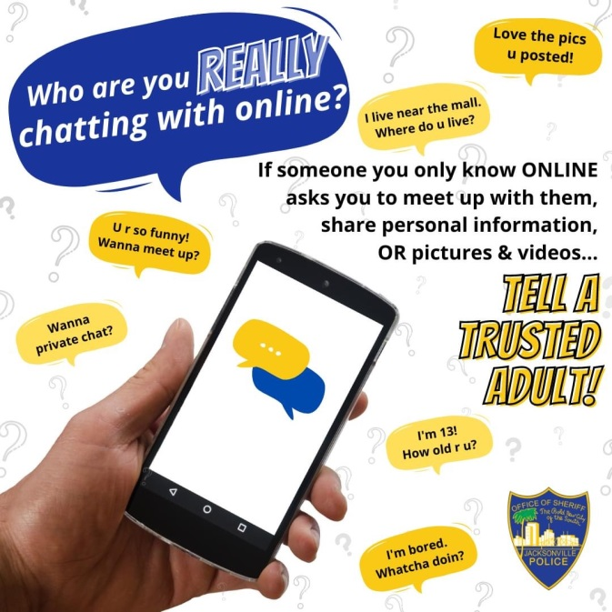
Proactive Measures

Slide 43
Thank you
Notes:
Tell others in your community about these free resources. Encourage your PTA to set up presentations. You can even talk to your child’s school about using NetSmartz teaching materials. When everybody works to confront these issues, your children become safer and are more prepared to protect themselves online.
Thank you!
(End of presentation.)

Slide 44
Thanks to …

